Slide 1
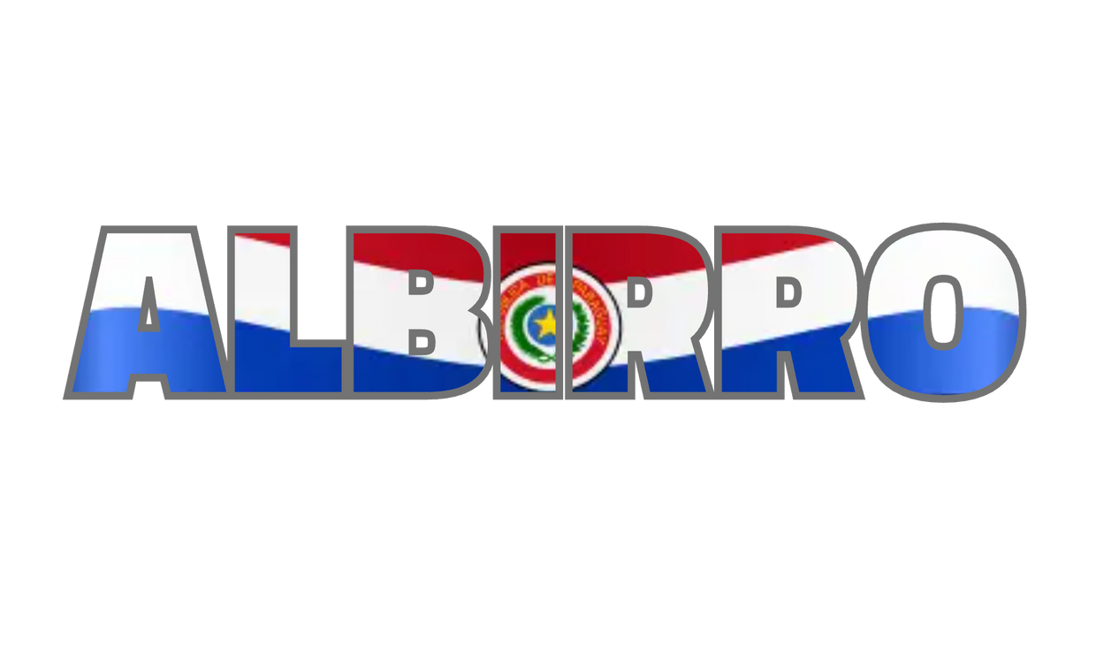
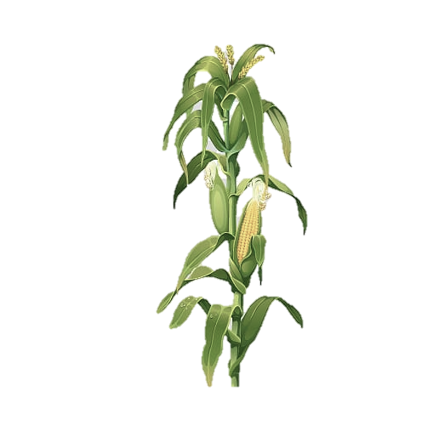
WILDCAT HACKATHON
2024
YANIK SITTA - DATA ANALYTICS
ELIANA SAMUDIO - AGRICULTURAL TECHNOLOGY MANAGEMENT

Slide 2
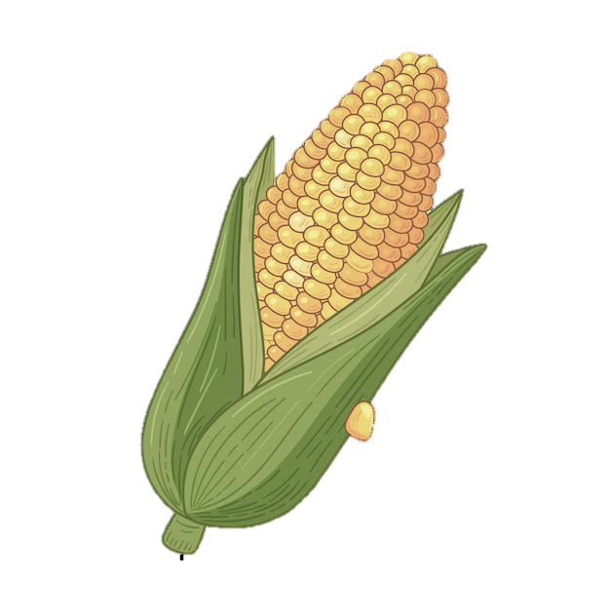
PROJECT OVERVIEW
PROGRAMMING AND FRAMEWORK
DATA PROCESSING
-Python
-Jupyter Notebooks, Pandas, Plotly and Panel.
Aggregation, cleaning, and visualization of environmental parameters. Data integration for real world deciosion-making.
MAIN INPUTS
OUTPUTS
TAPS Files
-Sentek, Arable, Soil Texture, Shallow Soil Sampling, Mesonet, NOAA.
Interactive dashboards to monitor weather, soil and irrigation conditions; automated irrigation recommendations to optimize sustainable use of water.

